Slide 1

Paper1
Dude, where’s my code?
Towards Optimization-Safe Systems:
Analyzing the Impact of Undefined Behavior
Xi Wang, Nickolai Zeldovich, M. Frans Kaashoek, and Armando Solar-Lezama
MIT CSAIL
Notes:
Xi Wang 是博后，SOSP13，Apsys 12 OSDI2012 Kint， SOSP11， OSDI2008
Improving Integer Security for Systems with KINT
Nickolai Zeldovich当完博后，成为AP了
F:Charles Piper Professor
Armando Solar-lezama:AP

Slide 2
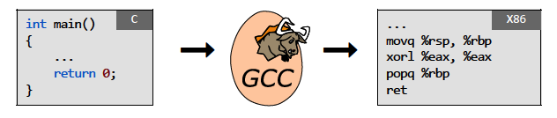
Paper1——Introduction
Belief： compiler == faithful translator
Not true if your code invokes undefined behavior

Slide 3
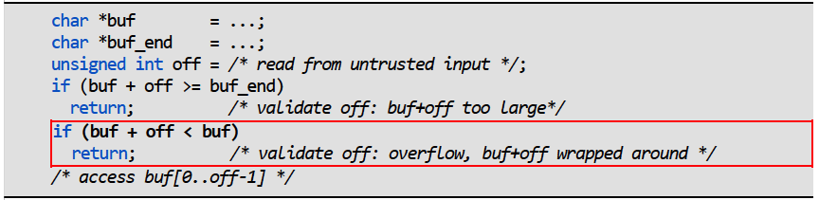
Paper1——Introduction
Example: compiler discards sanity check
C spec: pointer overflow is undefined behavior
gcc: buf + off cannot overflow, different from hardware!
gcc : if (buf + off < buf) ➔ if (false)
Attack: craft a large off to trigger buffer overflow

Slide 4
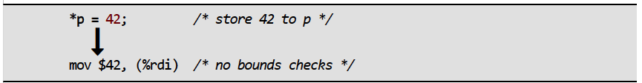
Paper1——Introduction
Undefined behavior allows such optimizations
Original goal: emit efficient code
Compilers assume a program never invokes undefined behavior
Example: no bounds checks emitted; assume no buffer overflow
undefined behavior: behavior, upon use of a non-portable or erroneous program construct or of erroneous data, for which this International Standard imposes no requirements ——C11(C standard revision)¹
¹http://www.open-std.org/jtc1/sc22/wg14/www/docs/n1570.pdf
Notes:
NOTE Possible undefined behavior ranges from ignoring the situation completely with unpredictable
results, to behaving during translation or program execution in a documented manner characteristic of the
environment (with or without the issuance of a diagnostic message), to terminating a translation or
execution (with the issuance of a diagnostic message).
EXAMPLE An example of undefined behavior is the behavior on integer overflow.
More in n1570, J2, 557

Slide 5
Paper1——Introduction
Examples of undefined behavior in C
Meaningless checks from real code: pointer p; signed integer x
Pointer overflow: | if (p + 100 < p)
Signed integer overflow: | if (x + 100 < x)
Oversized shift: | if (!(1 << x))
Null pointer dereference: | *p; if (p)
Absolute value overflow: | if (abs(x) < 0)
¹http://en.wikipedia.org/wiki/C11_(C_standard_revision)
Notes:
空指针引用

Slide 6
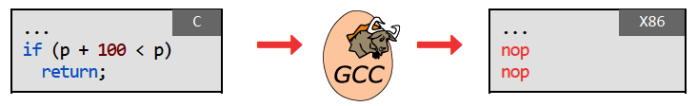
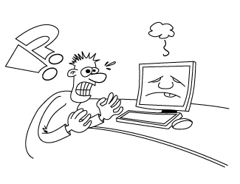
Paper1——Introduction
Problem: unstable code confuses programmers
Unstable code: compilers discard code due to undefined behavior
Security checks discarded
Weakness amplified
Unpredictable system behavior

Slide 7
Paper1——Unstable Code
Example: broken check in Postgres¹
Implement 64-bit signed division x/y in SQL
Some compilers optimize away the check
x86-64’s idivq traps on overflow
causing crash
¹http://www.postgresql.org/
Notes:
The world’s most advanced open-source database

Slide 8
Paper1——Unstable Code
Example: fix check in Postgres
The paper’s proposal:
“it’s an overflow check so it should check for overflow”
Developer’s fix:
“we don’t want the constant INT64_MIN; it’s less portable”
Still unstable code: time bomb for future compilers

Slide 9


Paper1——Unstable Code
bug #30475 - assert(int+100 > int) optimized away¹
This will create MAJOR SECURITY ISSUES in ALL MANNER OF CODE. I don’t care if your language lawyers tell you gcc is right. . . . FIX THIS! NOW!
I am sorry that you wrote broken code to begin with . . . GCC is not going to change.
a gcc user
a gcc developer
¹http://gcc.gnu.org/bugzilla/show_bug.cgi?id=30475

Slide 10
Paper1——Unstable Code
Test existing compilers
12 C/C++ compilers
gcc | clang
aCC(HP) | armcc(ARM)
icc(Intel) | msvc(Microsoft)
open64 | pathcc(PathScale)
suncc | xlc(IMB)
ti(TI’s TMS320C6000) | windriver(Wind River’s Diab)

Slide 11
Paper1——Unstable Code
Examples of unstable code
Meaningless checks from real code:
pointer; singed integer x
Pointer overflow: | if (p + 100 < p) | if (false)
Signed integer overflow: | if (x + 100 < x) | if (false)
Oversized shift: | if (!(1 << x)) | if (false)
Null pointer dereference: | *p; if (p) | if (false)
Absolute value overflow: | if (abs(x) < 0) | if (false)

Slide 12
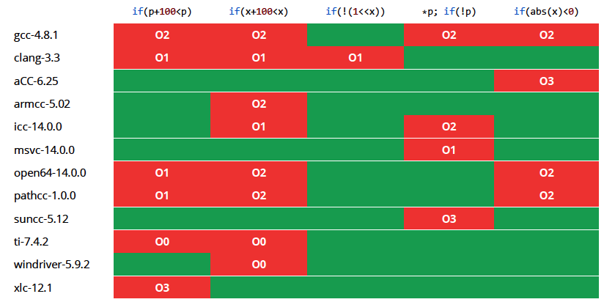
Paper1——Unstable Code
Compilers Often discard unstable code

Slide 13
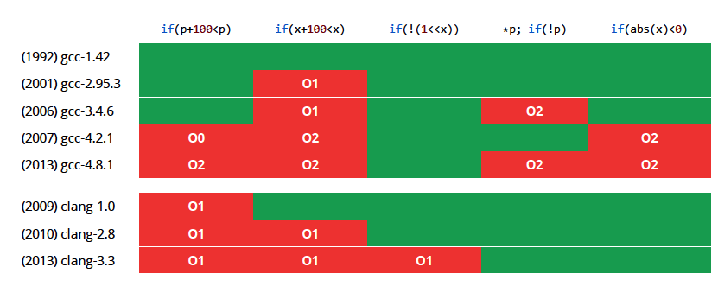
Paper1——Unstable Code
Compilers become more aggressive over time

Slide 14
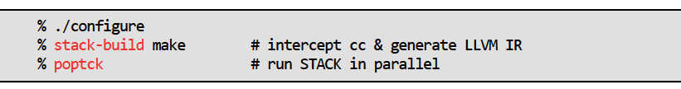
Paper1——Unstable Code
Observation
Compilers silently remove unstable code
Different compilers behave in different ways
Change/upgrade compiler ➔ broken system
Need a systematic approach
The paper’s approach: precisely flag unstable code
C/C++ source → LLVM IR → STACK → warnings
Notes:
利用clang将c++转中LLVM 中间代码，分析LLVMIR

Slide 15
Paper1——Evaluation
How to avoid unstable code
Programmers
Fix bugs
Workaround: disable certain optimizations
Compilers & checkers
Many bug-finding tools fail to model C spec correctly
Use the paper’s ideas to generate better warnings
Language designers: revise the spec
Eliminate undefined behavior? Perf impact?

